Slide 1
All About Data Science
Tarun Sharma
July 7, 2020

Slide 2

Welcome onboard ...

Slide 3
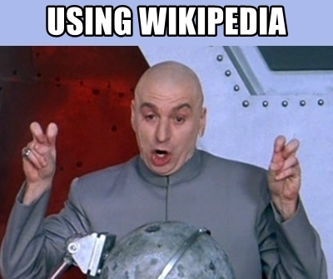
What is Data Science?
Data science is an interdisciplinary field that uses scientific methods, processes, algorithms and systems to extract knowledge and insights from many structural and unstructured data.

Slide 4
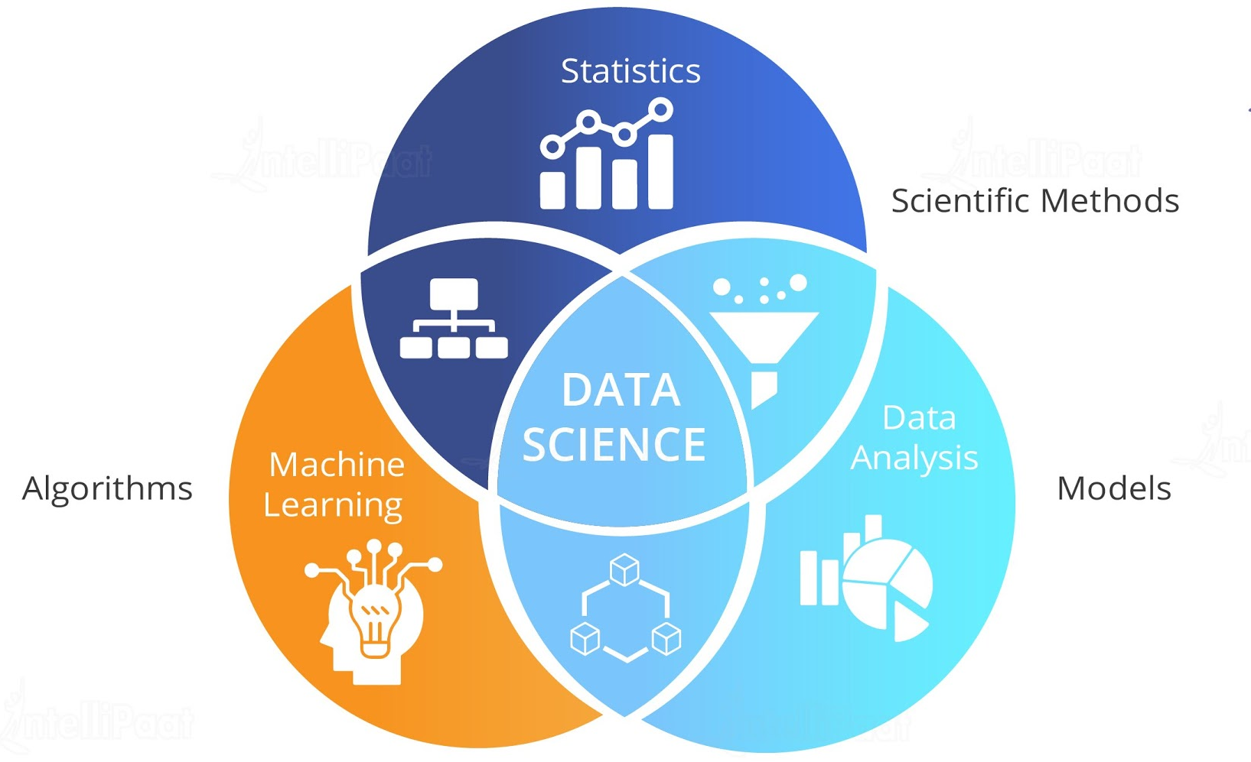
One in all ..

Slide 5
Where we use Data Science?
Formally written as - Application of Data Science

Slide 6
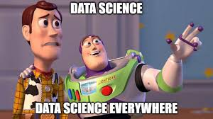
The truth has been spoken...

Slide 7
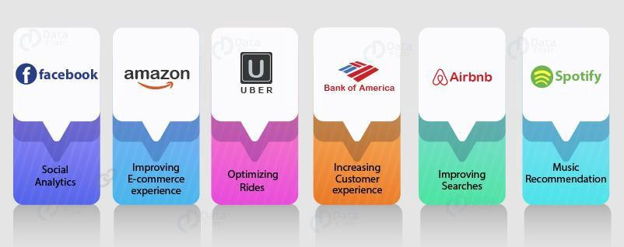
Sky is not the limit in Data Science. Hardware is.

Slide 8
What's inside Data Science?
The building blocks of Data Science

Slide 9
Inside Data Science
The Data
Data Collection
Data Wrangling & Cleaning
Data Warehousing
Data Visualization
Data Analysis
The Model
Model Creation
Model Evaluation
Model Deployment

Slide 10
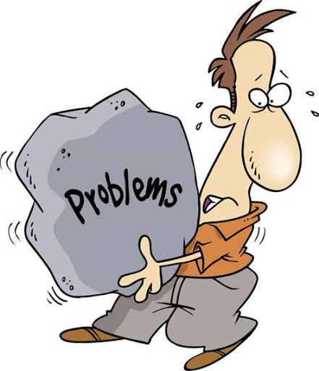

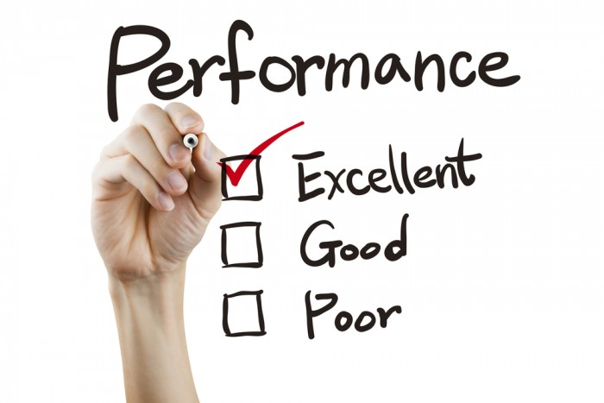

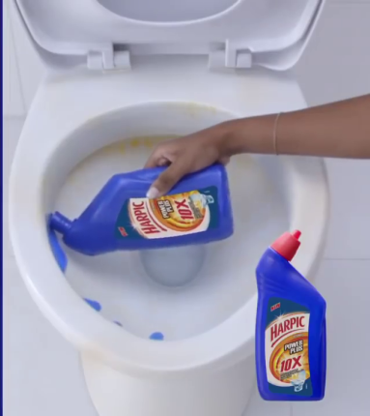

Problem
Data Collection
& Wrangling
Data Analysis
Creating
Model
Evaluation

Slide 11


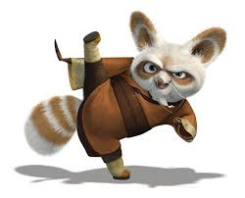
What you need to know?
PO
Master Shifu
Master Oogway

Slide 12
Po
The beginner

Slide 13
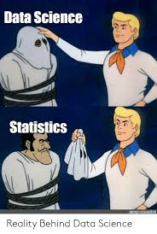
The Maths
Linear Algebra
Statistics
Coordinate Geometry (as per taste)
The Language
Python / R / Julia / MATLAB / Java / C++

Slide 14
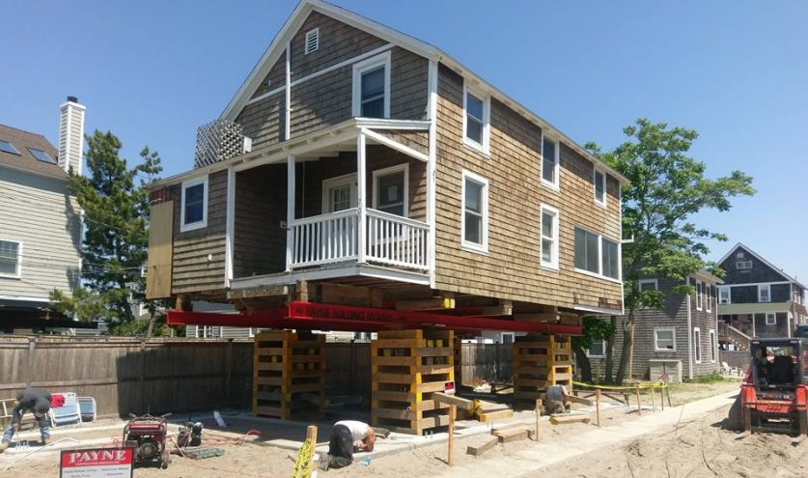
These are the foundation for everything

Slide 15
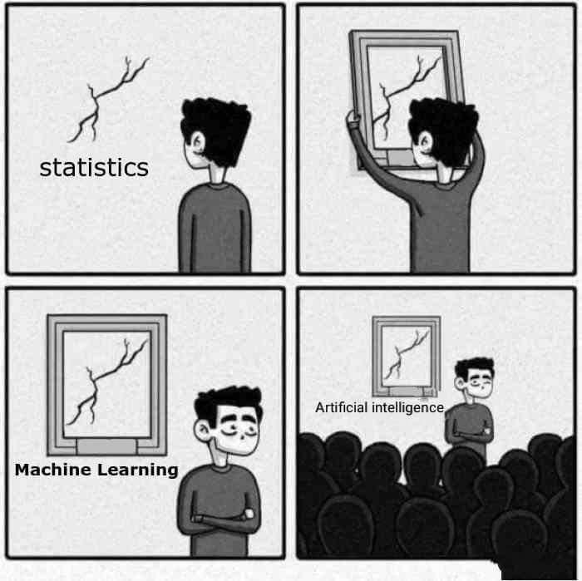
The Machine Learning
Supervised Learning
Logistic Regression
Linear Regression
Naive Bayes
Decision Tree
Random Forest
Unsupervised Learning
Clustering

Slide 16
What will help you?
Pandas
NumPy
Matplotlib
Scikit Learn

Slide 17
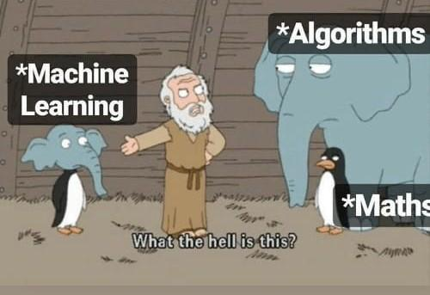
It's all maths...

Slide 18
Master Shifu
The intermediate

Slide 19
More Maths
Inferential & Descriptive Statistics
Calculus

Slide 20
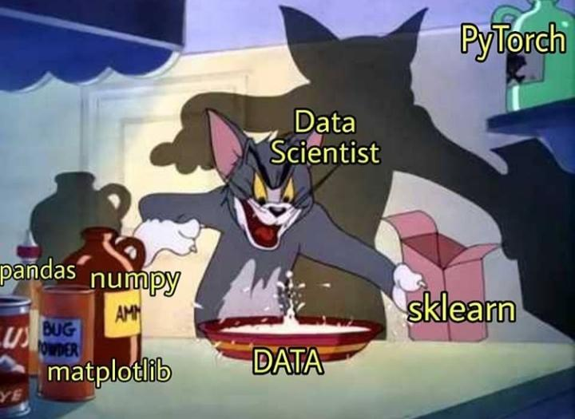
More in Machine Learning
Dimensionality Reduction (PCA etc.)
Model Evaluation
a) AUC ROC curve
b) Precision and Recall
Exploratory Data Analysis (EDA)

Slide 21
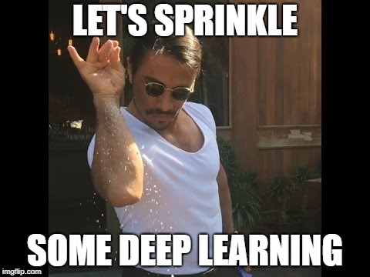
Let’s introduce the Beast: Deep Learning

Slide 22
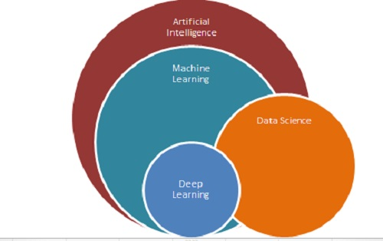
You must to know
Artificial Neural Network
Convolutional Neural Network
Recurrent Neural Network
What will help you
Tensorflow
Keras
PyTorch
Caffe

Slide 23
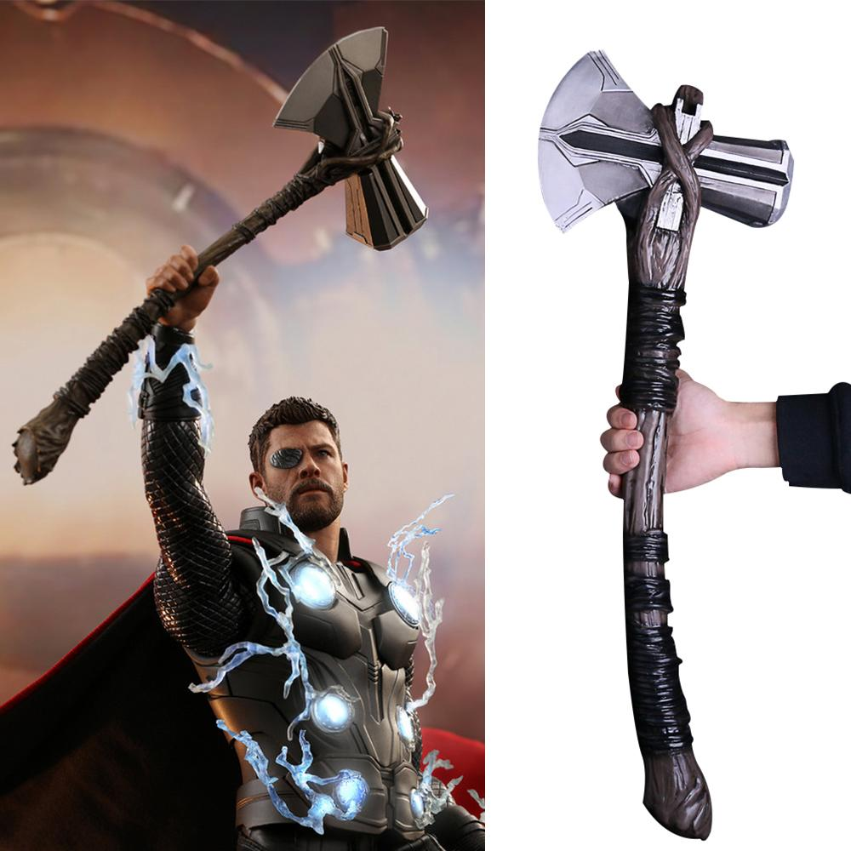
But you will still need a Stormbreaker ...

Slide 24

=

Slide 25
Master Oogway
The Expert

Slide 26
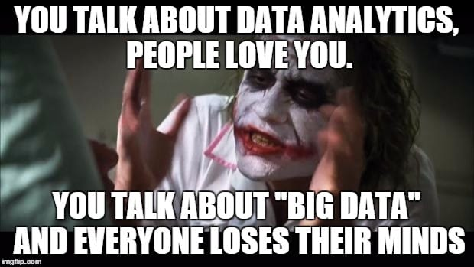
The Data
Big Data
SQL (Mysql, PostgreSQL etc.)
NoSQL (MongoDB, Cassandra etc.)
The Storytelling
Power BI
Tableau
More Visualization Tool

Slide 27
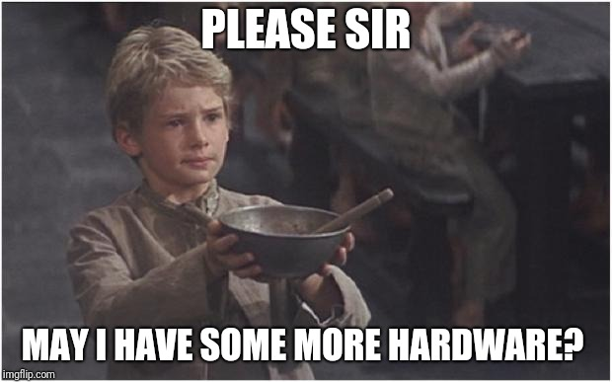
The Cloud & Processing
GCP /AWS / Azure
GPU / TPU Programming

Slide 28
And ...

Slide 29


Slide 30
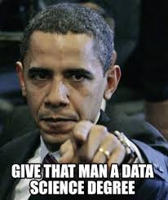
That’s all for today.
Rest will be covered soon.
Thank You !

